Slide 1
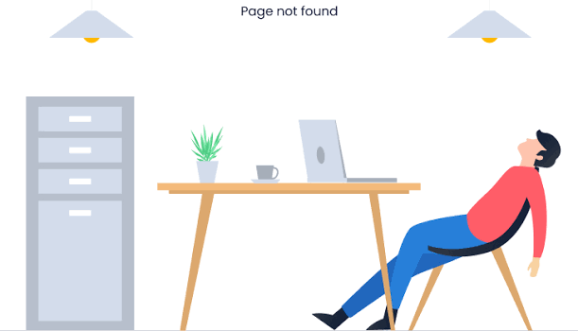
Real-time Text Analytics
Quiz 1
By Group:
404
NOT FOUND

Slide 2

Q1
Count “Harry” word
then print “Harry” word count every 5 seconds
eiei

Slide 3

Real-time Harry Word Count System Design
Kafka Cluster
KafKa Stream
Publisher
Input Topic
WordCount
Harry-Potter.txt
Producer
Output Topic
Subscriber
Consumer

Slide 4
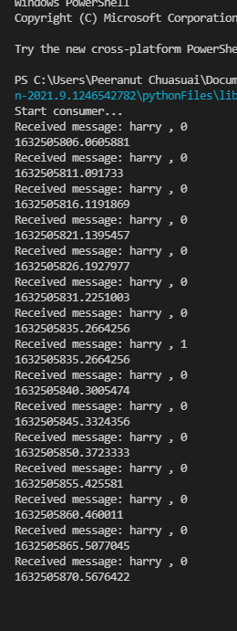
PICTURE HERE
OUTPUT

Slide 5
Q2
TF-IDF
find important words in each page using TF-IDF technique.

Slide 6


Real-time TF-IDF System Design
Publisher
PySpark on Colab
Harry-Potter.txt
Producer
Input Topic
Page TF-IDF
Send items:
[(Page Num, Page Detail)]
Print Output

Slide 7
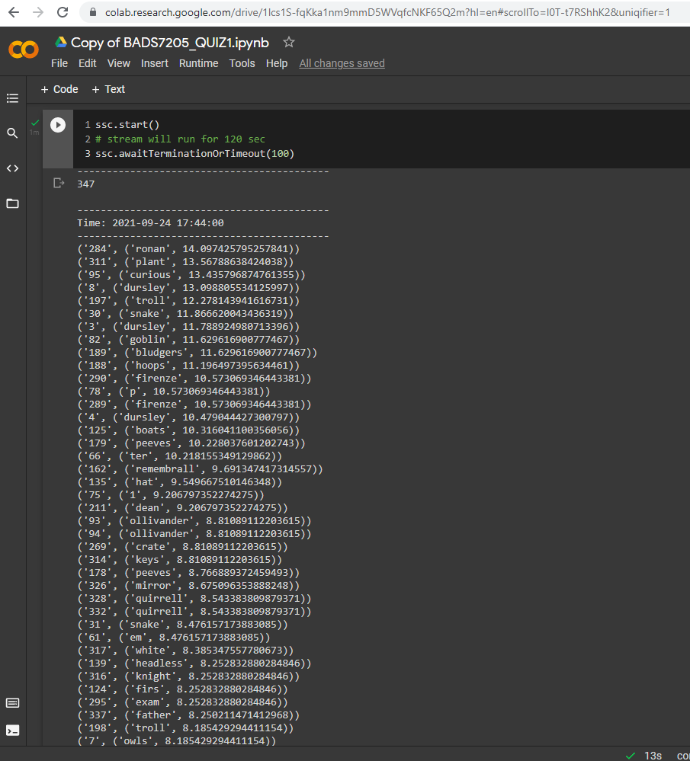
OUTPUT

Slide 8
LASTLY

Slide 9
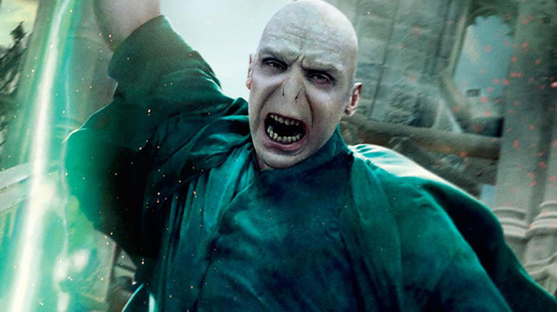
Avada kedavra!!!

Slide 10

THANK YOU

Slide 11
Real-time Text Analytics
Quiz 1
By Group: 404 Not Found

Slide 12
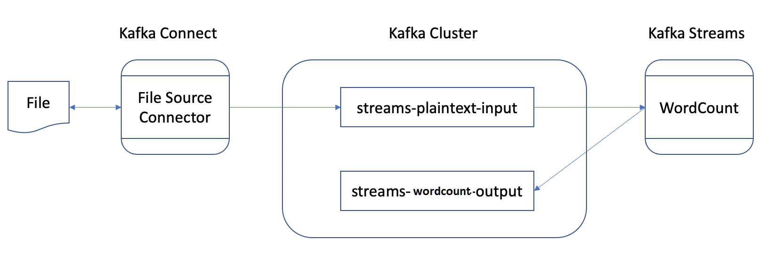
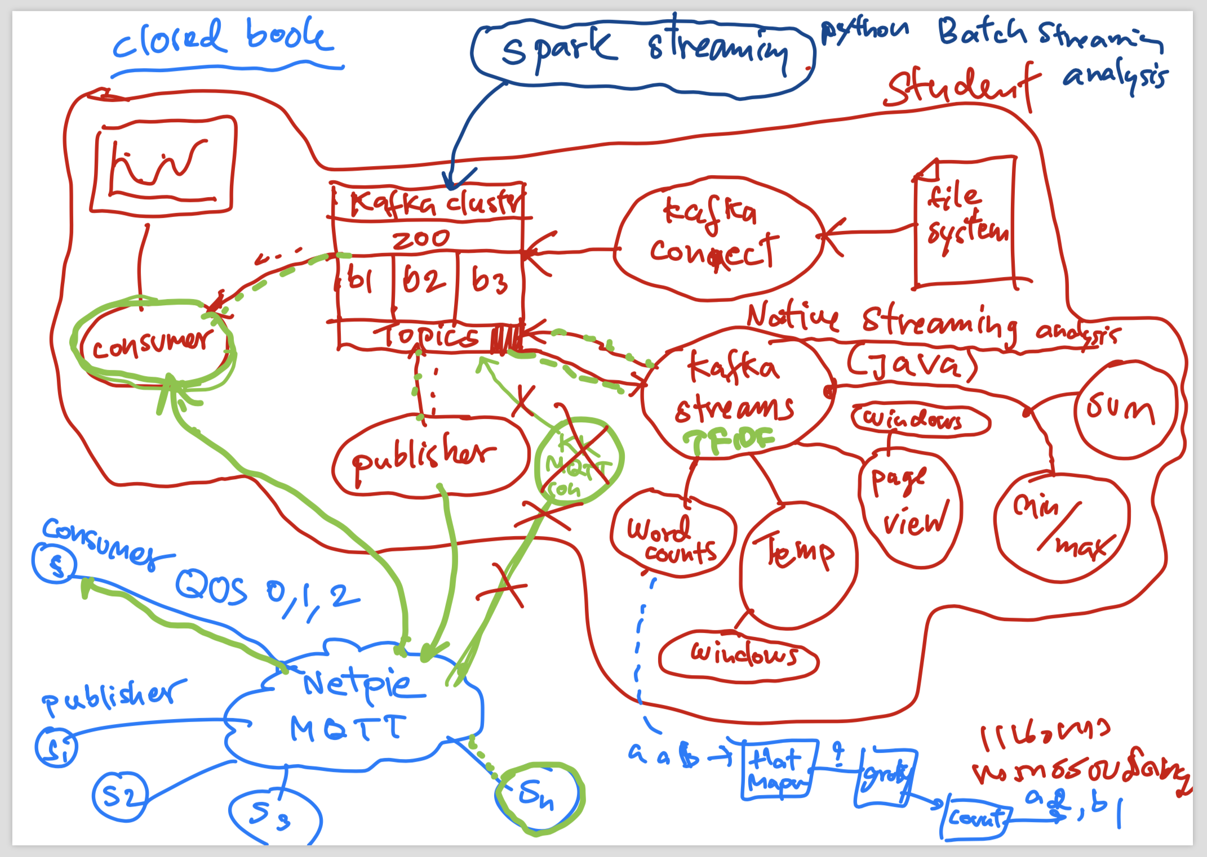

Slide 13
Quiz 2 :TF-IDF
Kafka Cluster
KafKa Stream
Publisher
Input Topic
Page TF-IDF
Harry-Potter.txt
Producer
Output Topic
(Send whole doc)
Subscriber
Consumer

Slide 14
Quiz 2 :TF-IDF
Kafka Cluster
PySpark
Publisher
Input Topic
Page TF-IDF
Harry-Potter.txt
Producer
Output Topic
(Send whole doc)
Subscriber
Consumer

